Slide 1
VRDI Intro to GIS
Day 2: Census Data

Slide 2
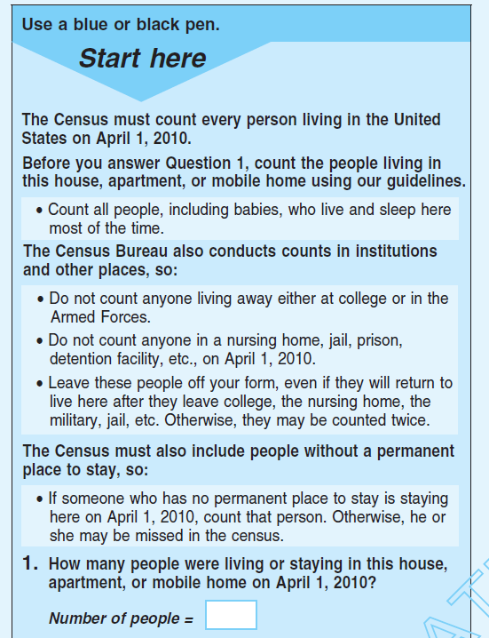
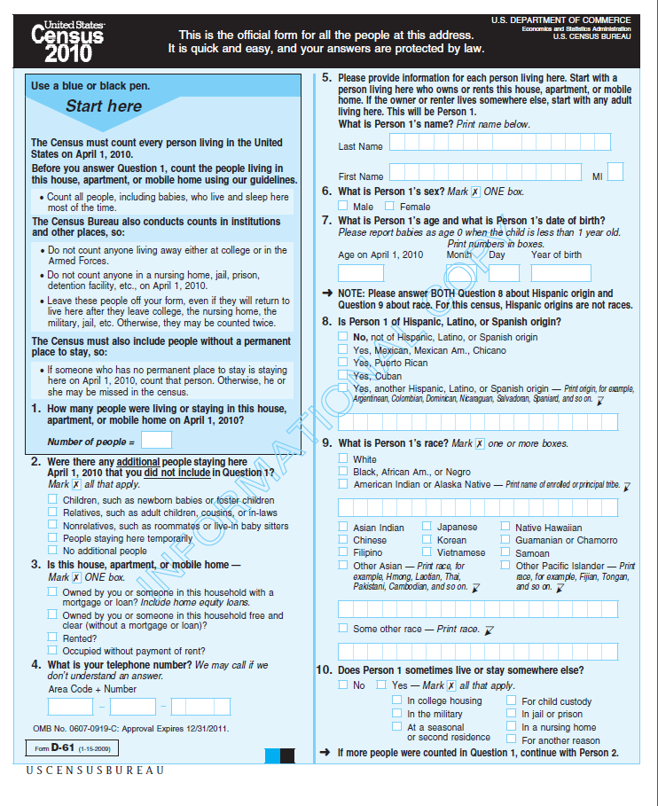
The Census Form
How many People

Slide 3
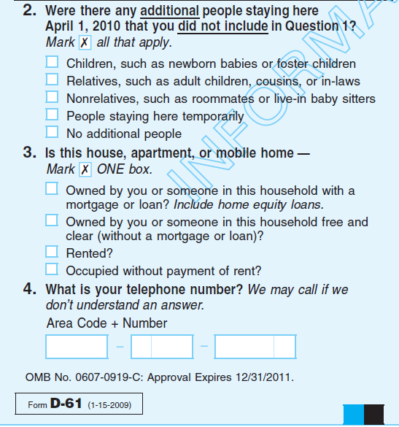
No really, how many people.
Rent or own?
Notes:
Highlight rent or own as it is important to the story of undercounting later on.

Slide 4
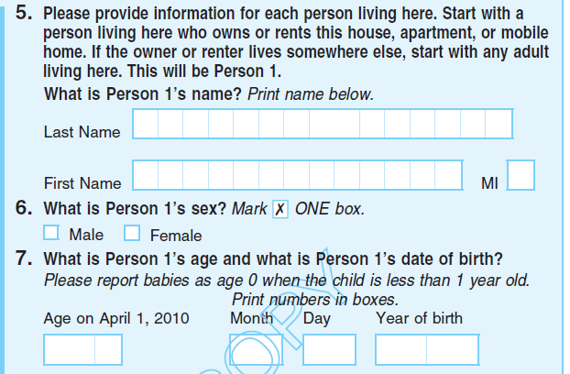
What is your name?
Sex?
Age?
DOB?

Slide 5
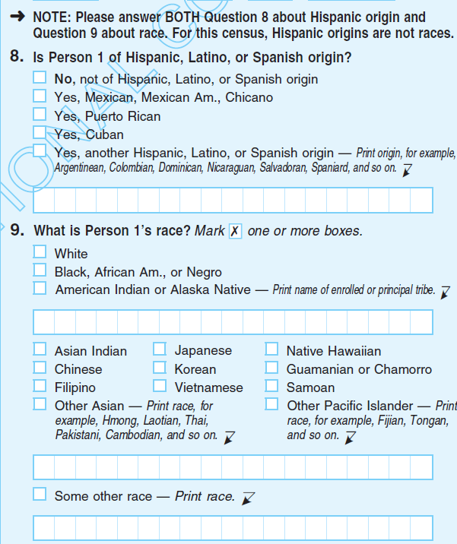
Are you Hispanic?
What is your race?
Check all that apply.
Notes:
Highlight “Check all that apply” it is important to the policy and politics piece

